Slide 1
Studies of quantum boltzmann machines
Philip K. Sørli Niane
University of Oslo

Slide 2
Outline
Motivation
Theory:
Machine Learning
Quantum Computing
Method
Results
Conclusion
Future prospects

Slide 3
Motivation
Goal of the thesis: Abstract/Intro from thesis

Slide 4
Theory: Machine learning
Introduction in thesis
Uses: Images, NLP…
Overfitting and different methods and such?

Slide 5
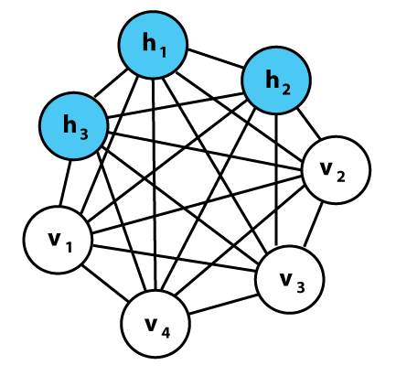
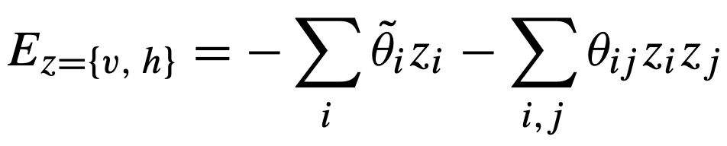
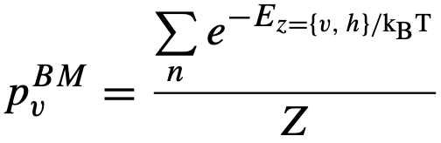
Classical Boltzmann machines
Powerful framework for modelling probability distributions.
Undirected graph structure- Store information in connection weights and biases
Stochastic generative neural network, with visible- and hidden nodes(layers)
Network structure linked to an energy function which facilitates probability distributions over possible node configurations:
Probability to observe certain configuration
Optimizing loss function

Slide 6
Theory: Quantum Computing
Intro and stuff like that
Examples of quantum circuits and gates and such

Slide 7
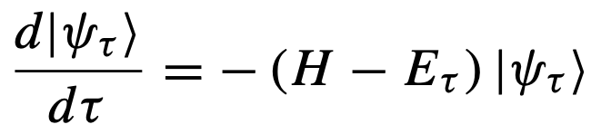

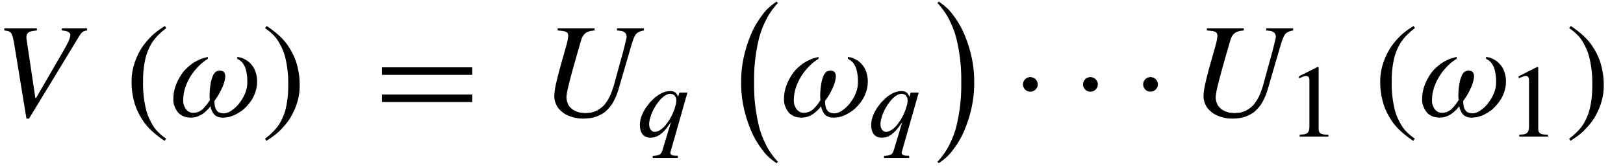
Variational Quantum Boltzmann machine
Imaginary time evolution used for classical ground state
Describe evolution (Wick-rotated S.E.):
Finite time →Gibbs states
Basic idea: Parameterized trial circuit:
.
McLachlan’s variational principle:
.
Basically, find the parameters that minimizes the equation

Slide 8
Method
Generate probability distributions
Bell state
Classification/Regression of classical data
Transaction dataset
MNIST(4 classes)
Franke function
Finding ground state energy of H₂
VarQITE
RBM- Neural network quantum states

Slide 9
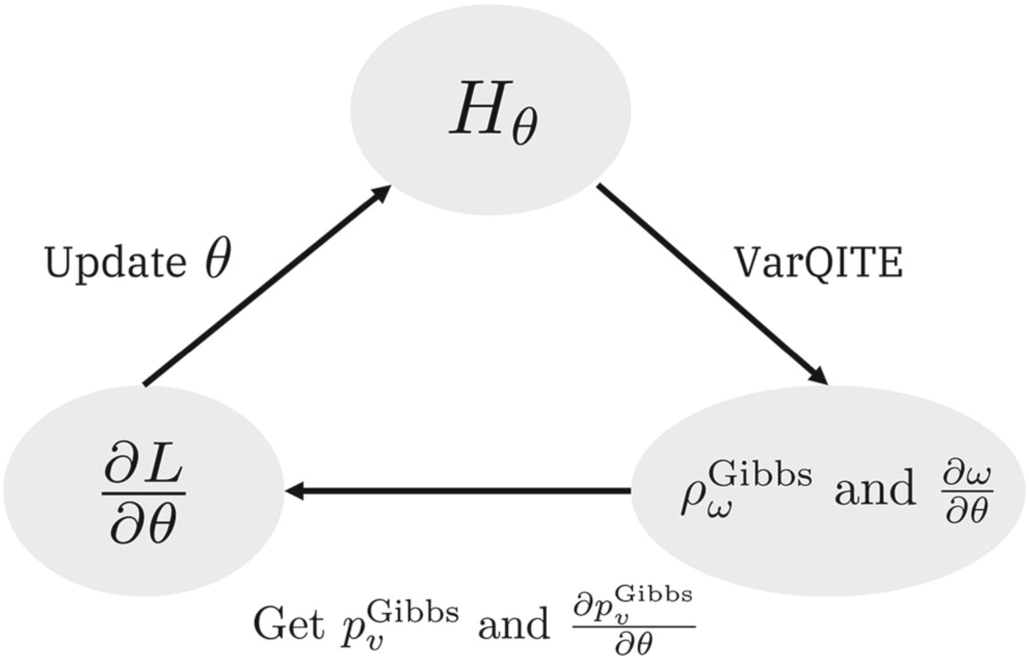
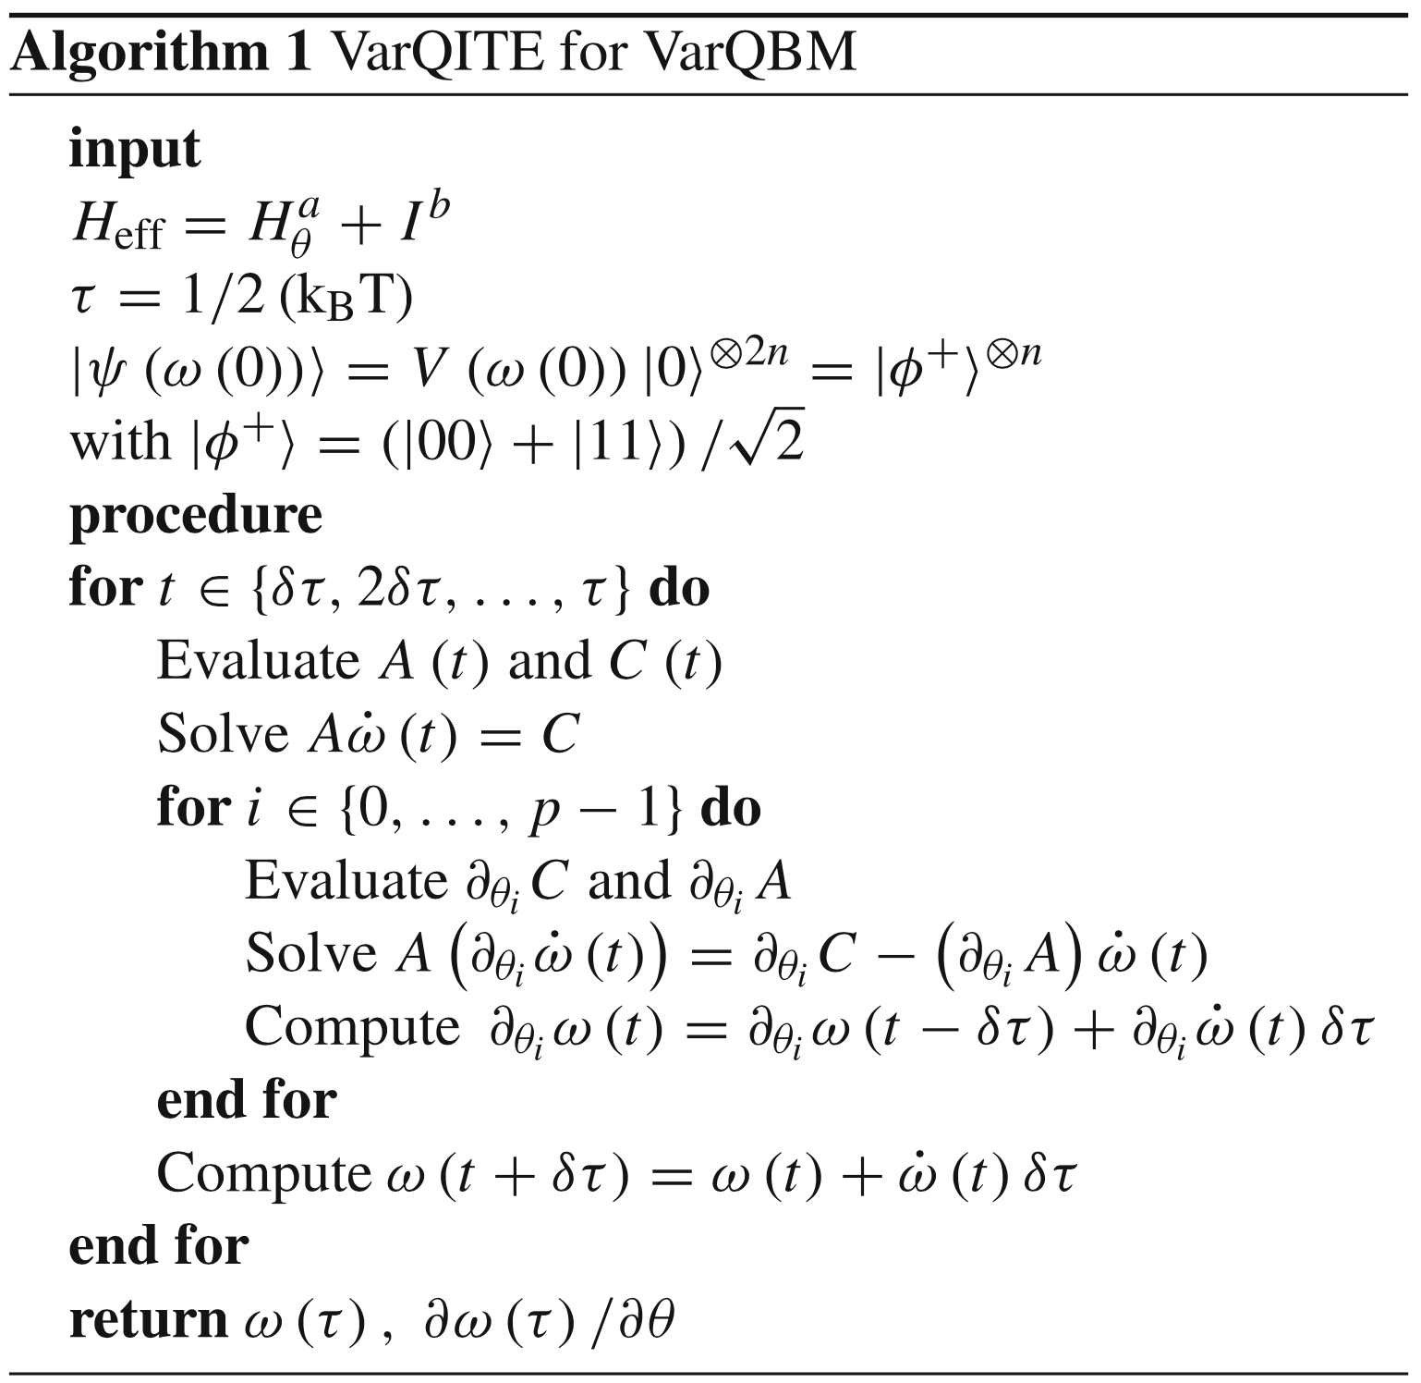
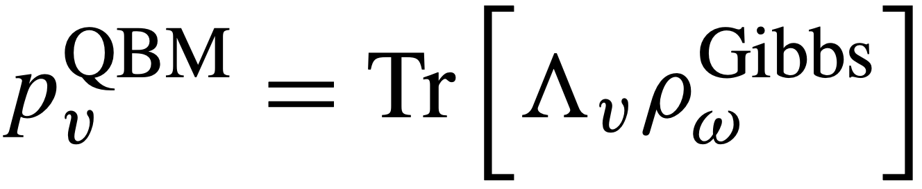
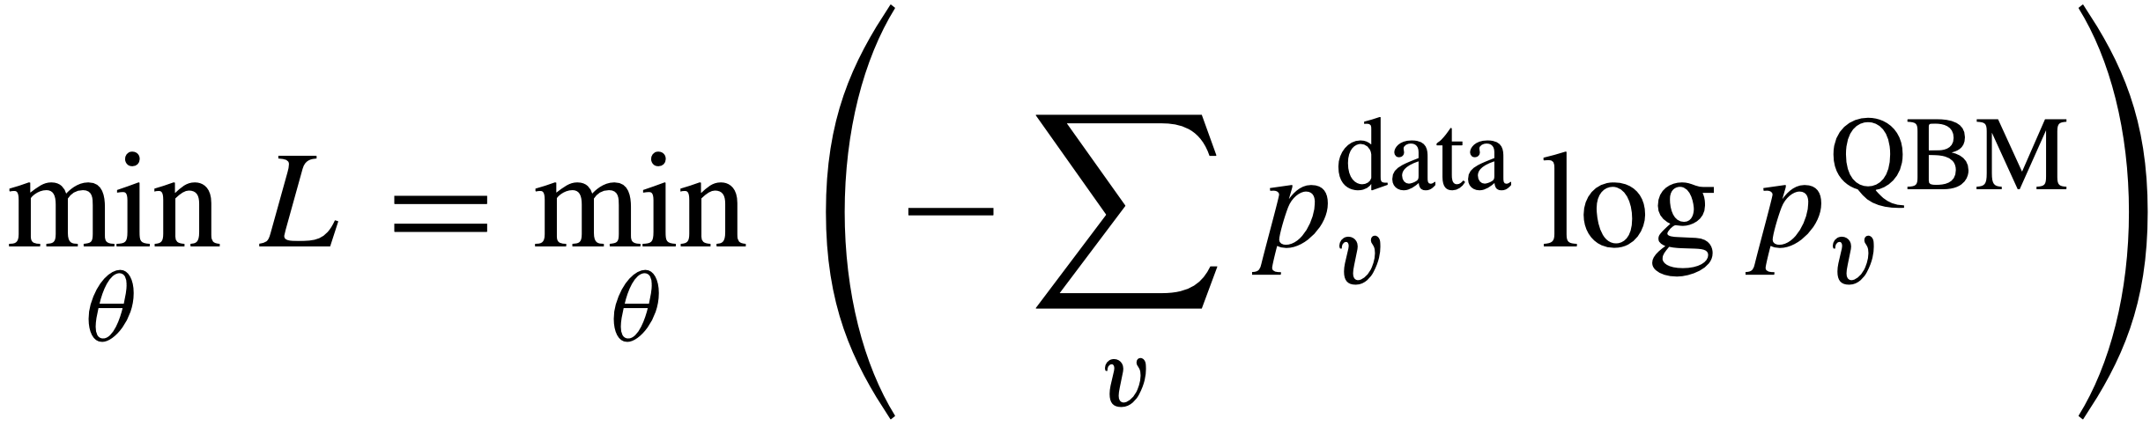
VARQbm: algorithm
Finds BM distribution from:
.
Minimizes loss
.

Slide 10
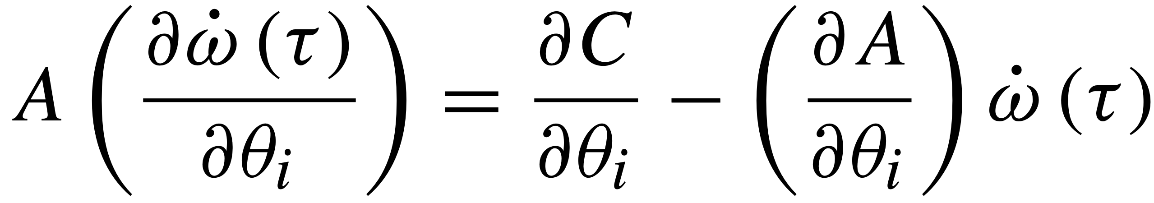

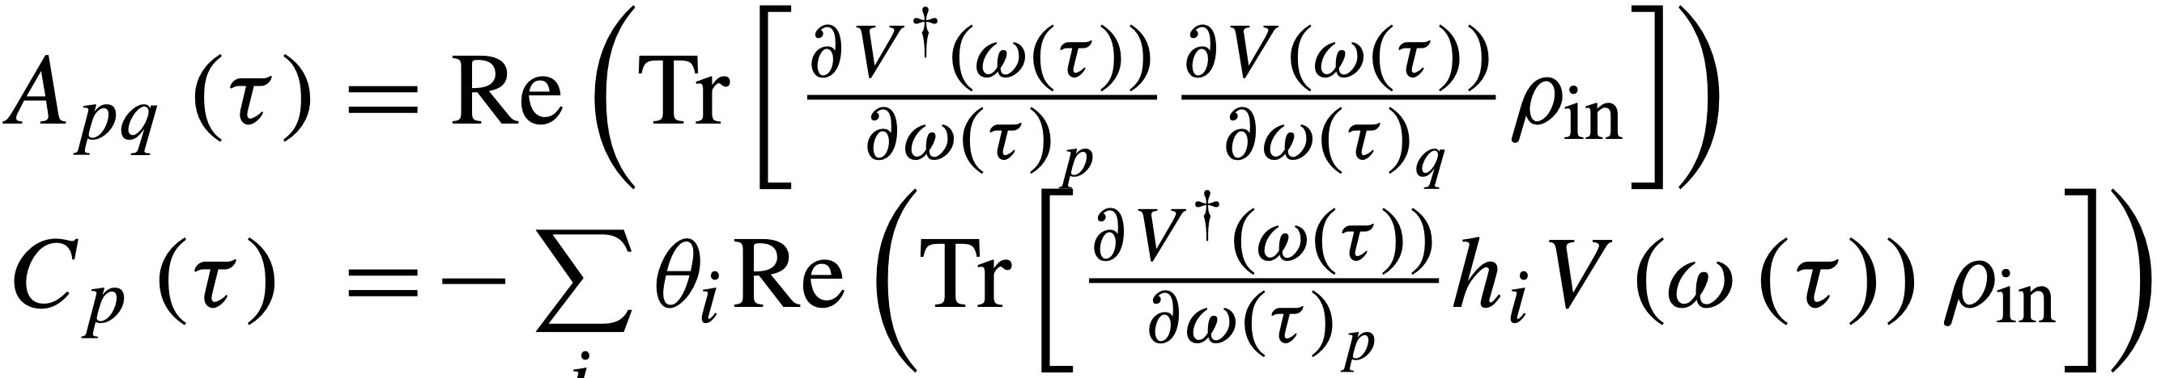
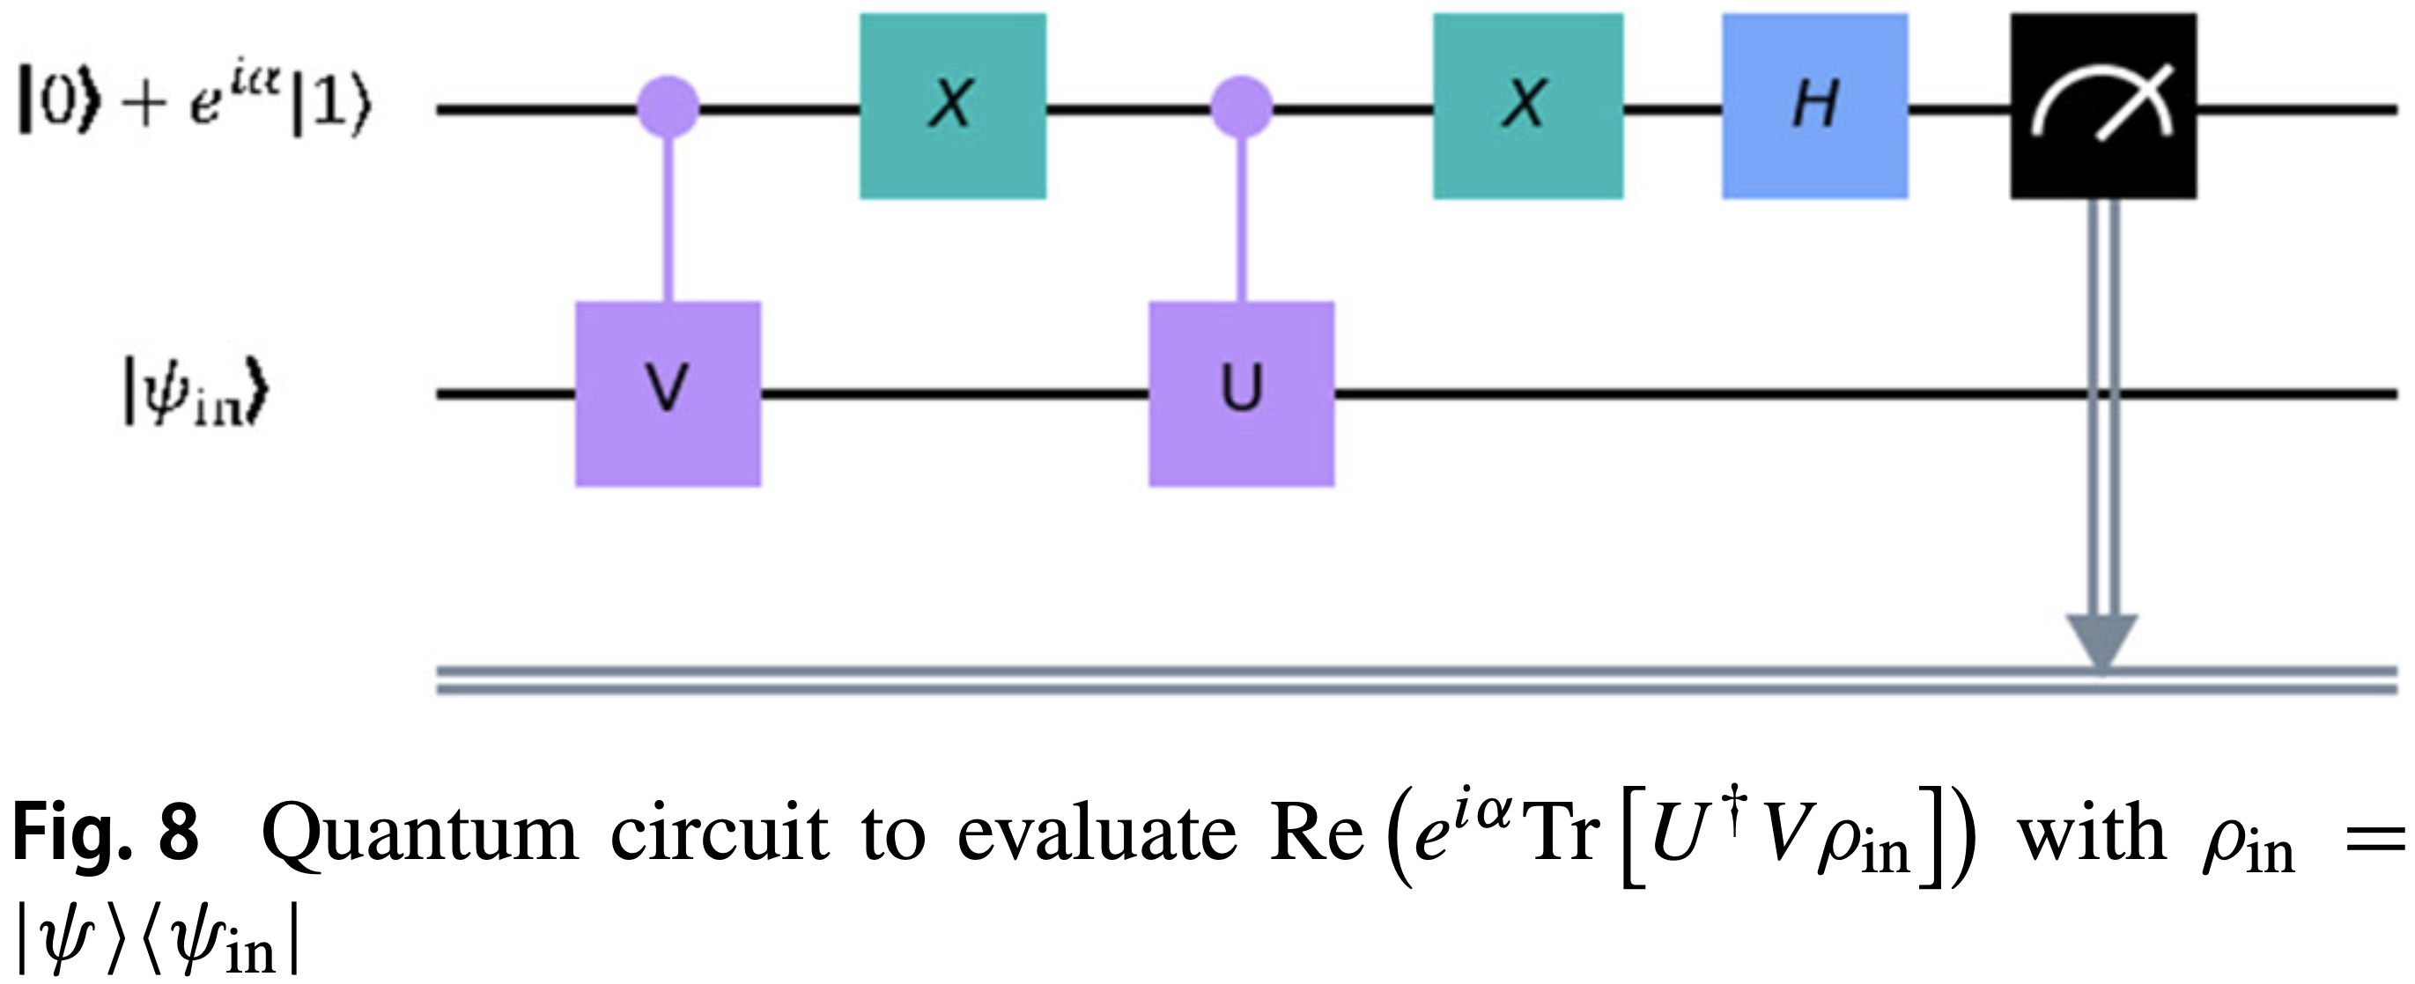
Main Challenge
Solving and
With
.
.
Solved using the generalized circuit:

Slide 11
Ansatzes and Hamiltonians

Slide 12
Neural Network- and Bias encoding

Slide 13
Optimizers and such extra things

Slide 14
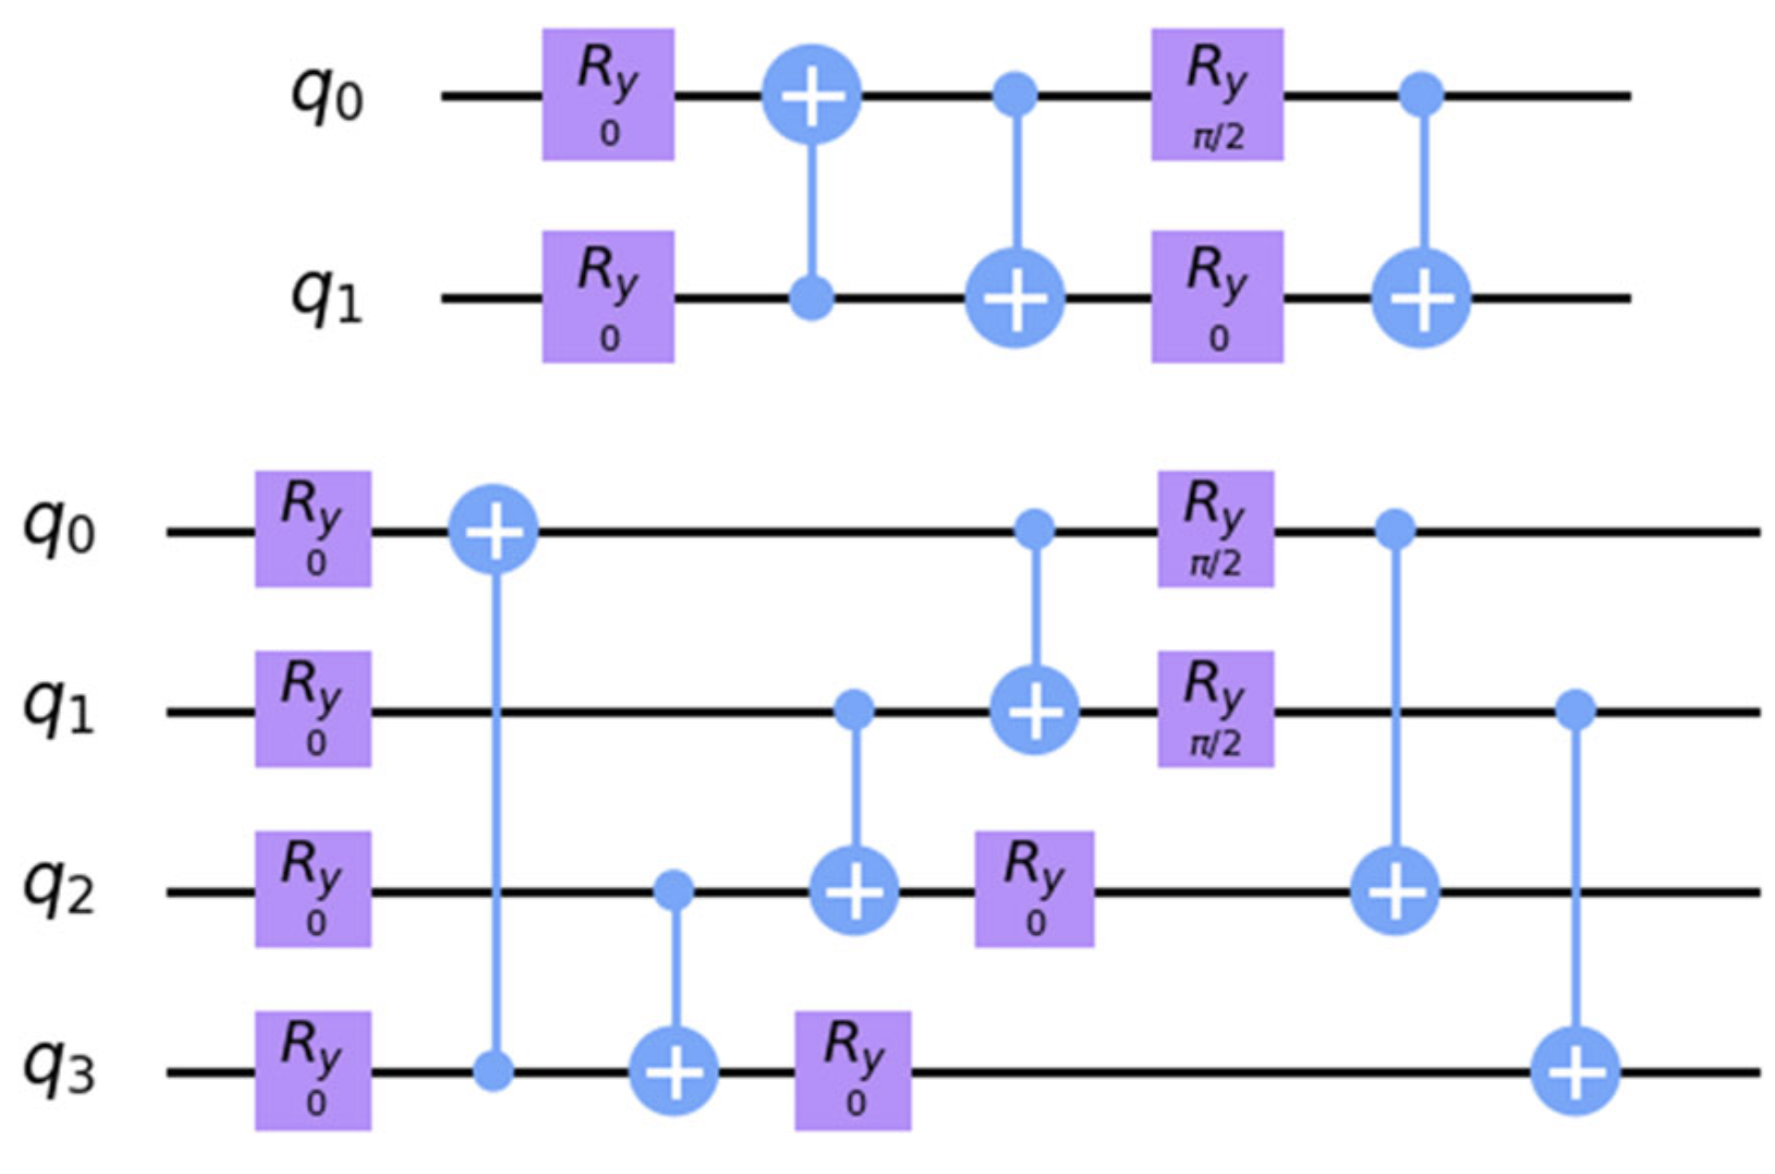
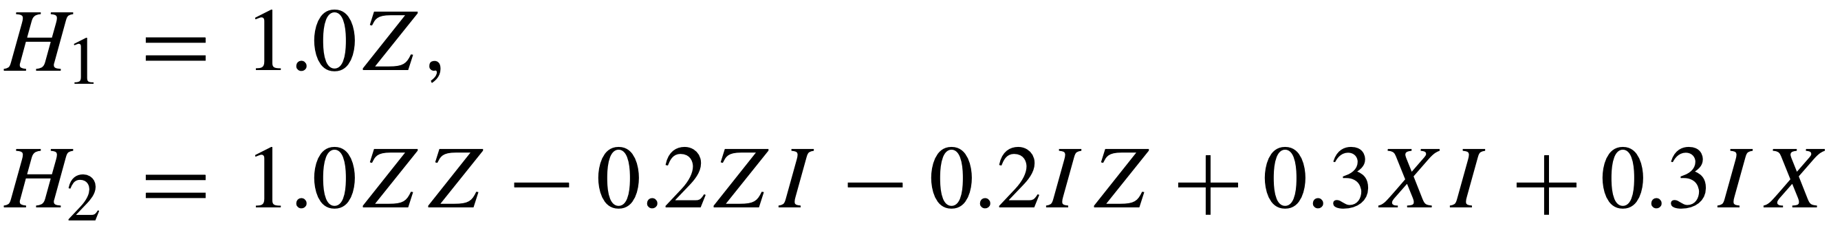
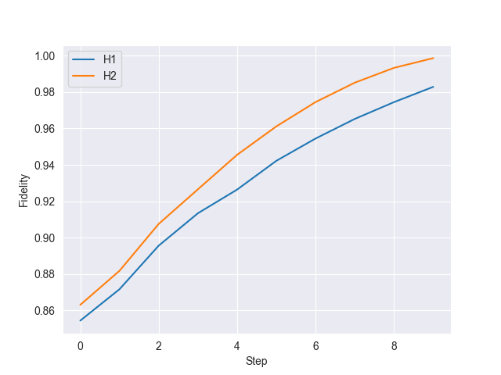
Benchmark: Generation of gibbs states/State preparation
Hamiltonians: Trial circuits:
.
.
10 steps
Ridge: Low lambda but not singular
λ with the least loss
Fidelity compared to analytical solution:
H1: 0.98 and H2: 1.0

Slide 15
RBM using Neural network quantum states(NQS)
Trial wave function and such, show some formulas

Slide 16
Results: Generating Target probability distribution
Insert results and figures and such

Slide 17
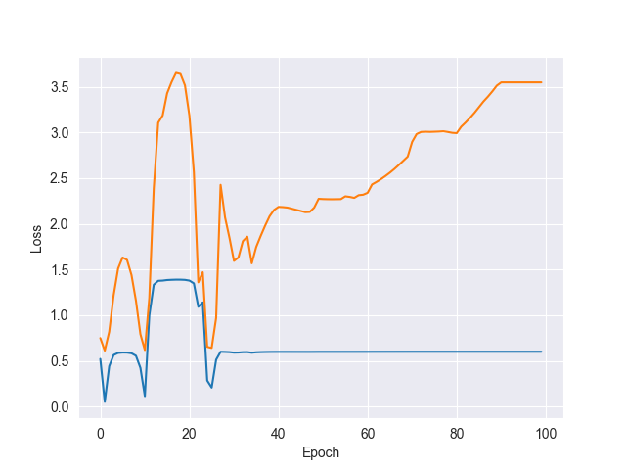
Results: Training the QBM
Reproduce [0.7, 0.3]
Hamiltonian: H= 𝛳₀ Z
Uniform distribution [-0.5,0.5]
AmsGrad optimizer,
𝛾=0.1, m1=0.7, m2=0.99
Ansatz 1
(Without finetuning and optimal parameters)
If 2 plots: Blue=L1 norm, Orange=Loss

Slide 18
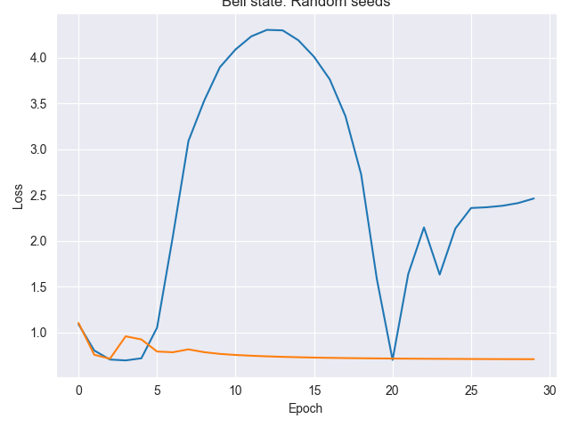
Results: Training the QBM
Hamiltonian: H= 𝛳₀ Z Z+𝛳₁ Z I +𝛳₂ I Z
Ansatz 2
Target: [0.5, 0, 0, 0.5]
𝛾=0.1, m1=0.8, m2=0.99
2 seeds, both loss

Slide 19
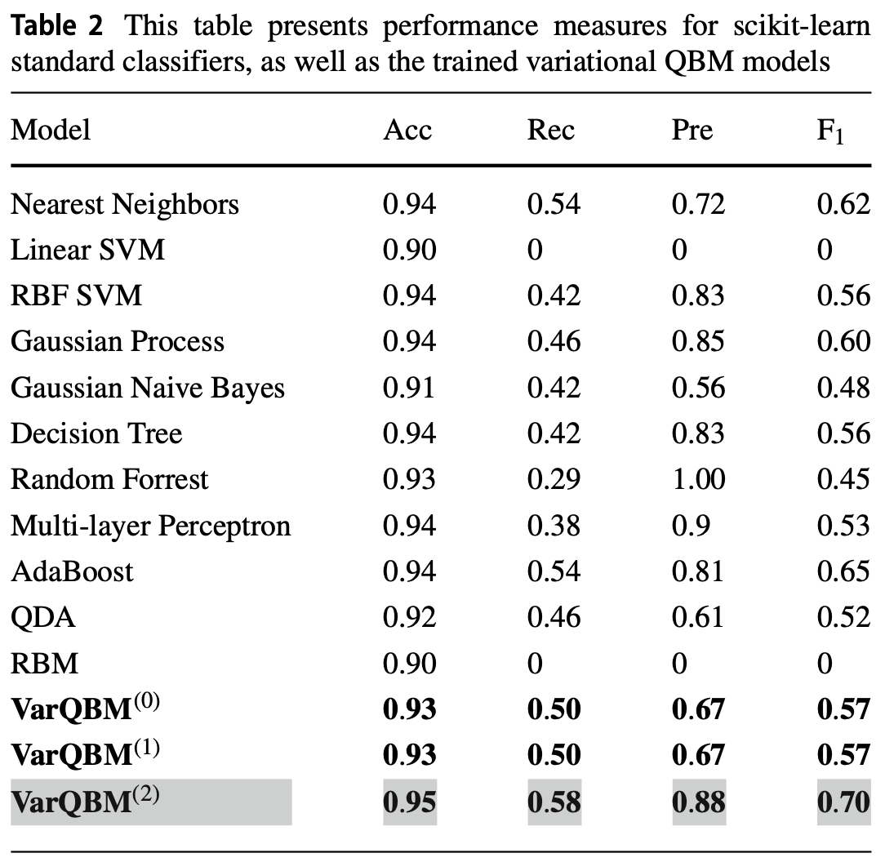
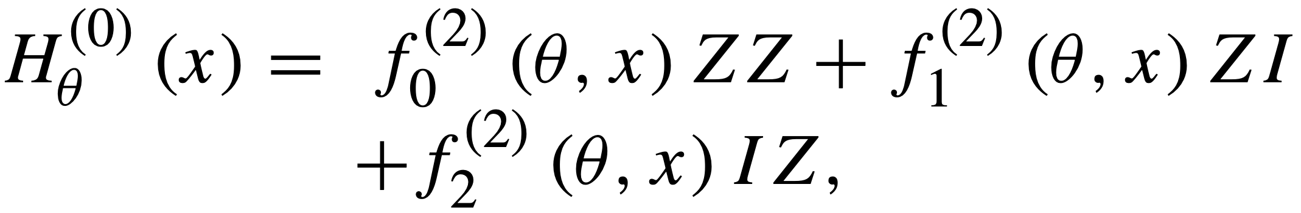
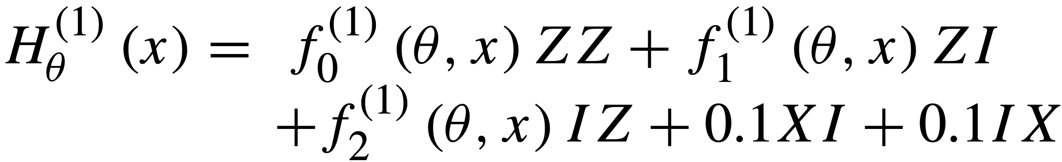
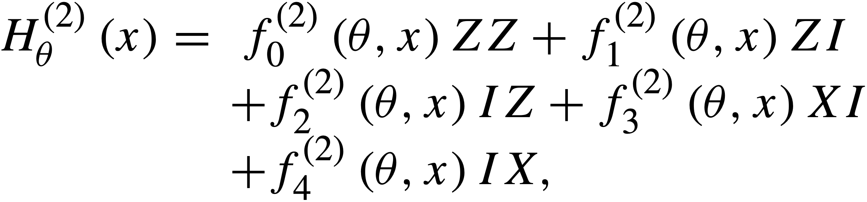
Further work
Focus a bit on the classical BM
Finetune both classical- and quantum BM
Reproduce more results from the article
Might try to overcome results from the article
achieved on the fraud dataset by testing some
more powerful Hamiltonians, these were used:

Slide 20
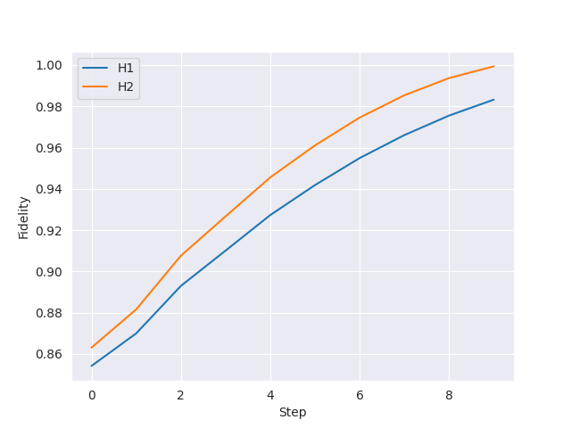
Results: State preparation
H₁=𝛳₀ Z
H₂=𝛳₀ ZZ+𝛳₁ IZ+𝛳₂ ZI
Fidelities 0.98 and 1.0 for H1 and H2
Think it is due to singular values
(3 of 4 elements along diagonal = 0)
‘However, since the algorithm is employed in
the context of machine learning, we do not
necessarily require perfect state preparation.‘

Slide 21
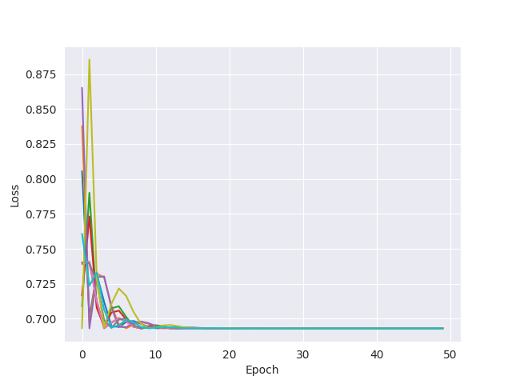
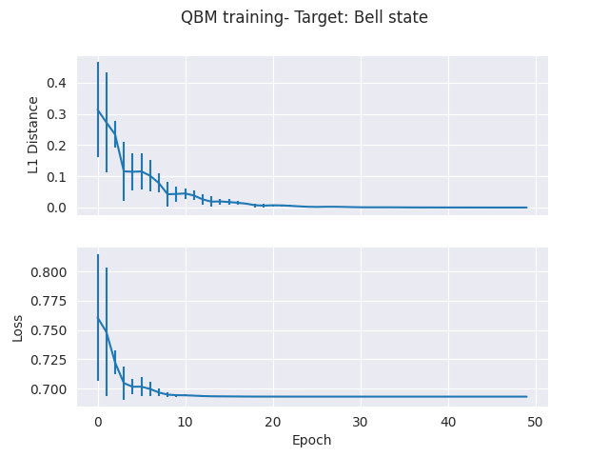
Results: H₁ Generating distribution
10 seeds, [-1, 1] uniform distribution
Target: [0.5, 0.5]

Slide 22
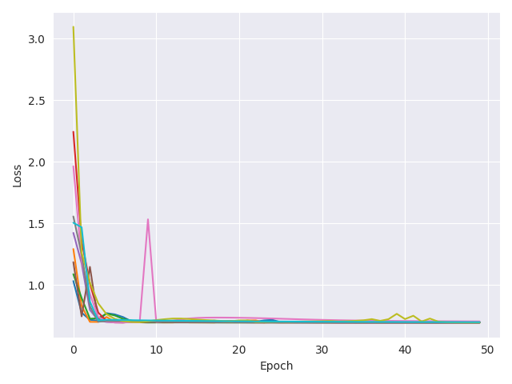
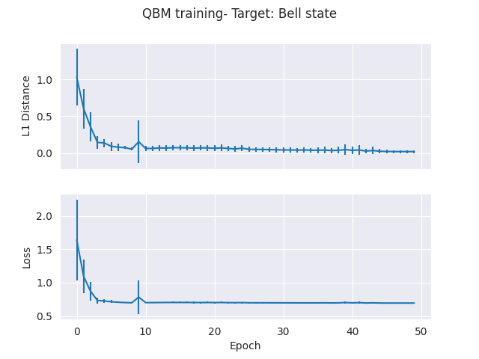
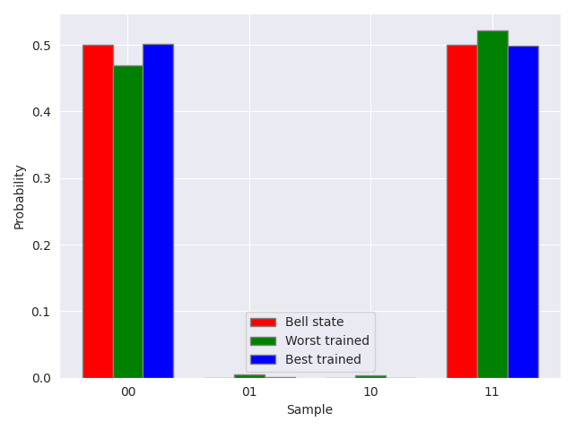
Results: H₂ Generating Bell State
10 seeds, [-1, 1] uniform distribution
Target: Bell state
Notes:
lr100.04H2_latest_10_seeds_both.png

Slide 23
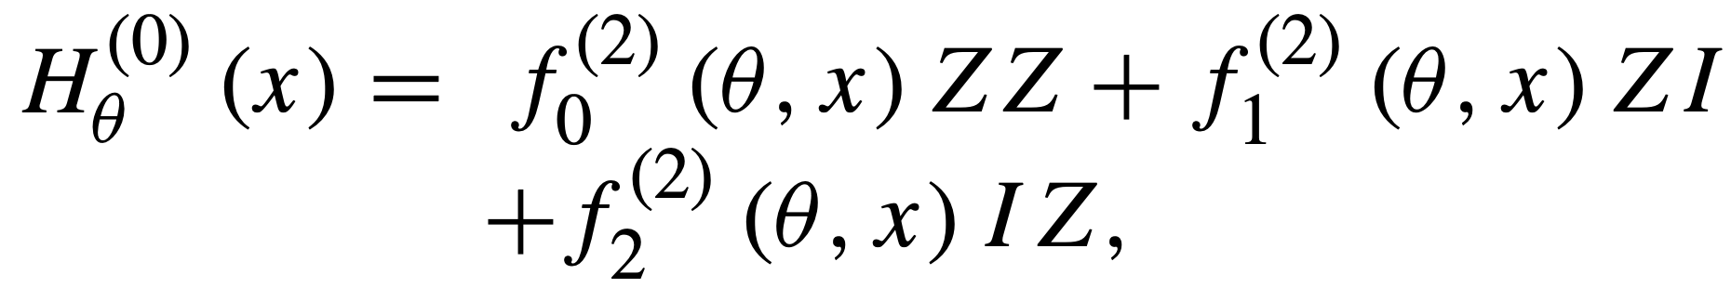
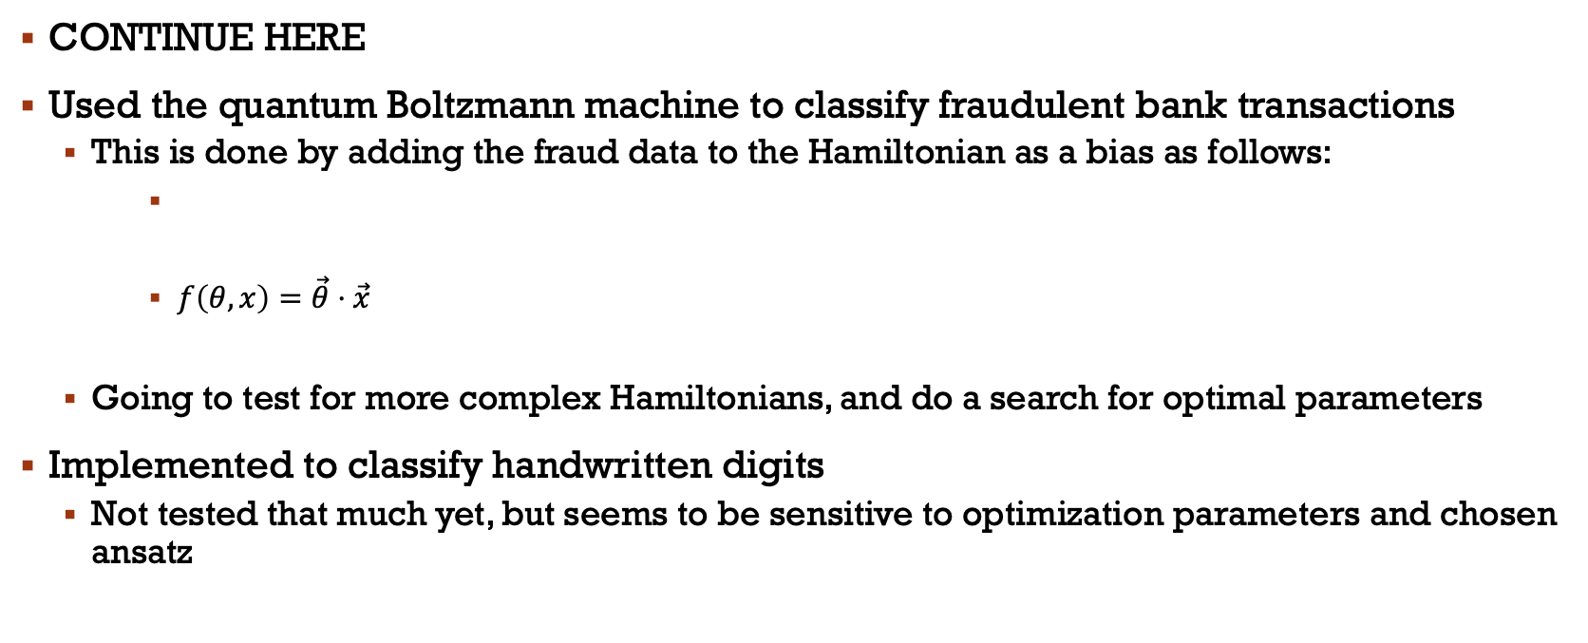
Discriminative Learning: Transaction dataset
CONTINUE HERE
Used the quantum Boltzmann machine to classify fraudulent bank transactions
This is done by adding the fraud data to the Hamiltonian as a bias as follows:
$f\left(θ, x\right)=\vec{θ}⋅\vec{x}$
Going to test for more complex Hamiltonians, and do a search for optimal parameters
Implemented to classify handwritten digits
Not tested that much yet, but seems to be sensitive to optimization parameters and chosen ansatz

Slide 24
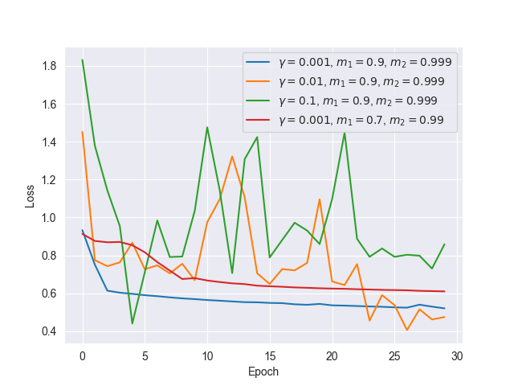
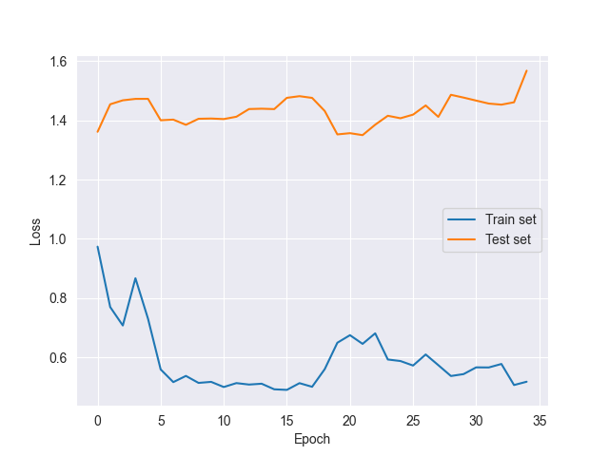
Fraud: Playing a bit with parameters
10 samples to inspect that the loss reduces
30 samples, 𝛄=0.005

Slide 25
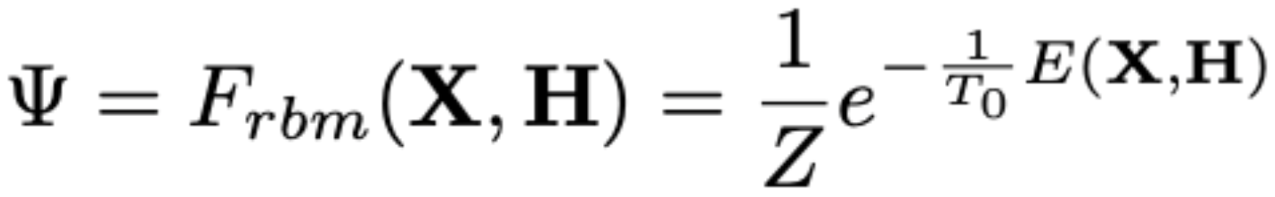
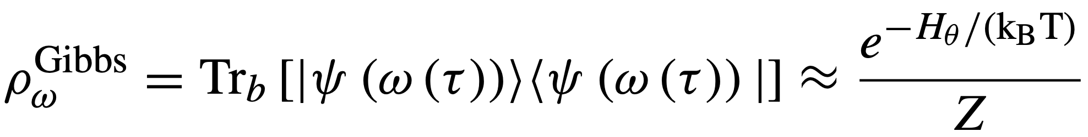
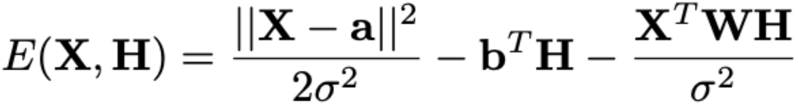
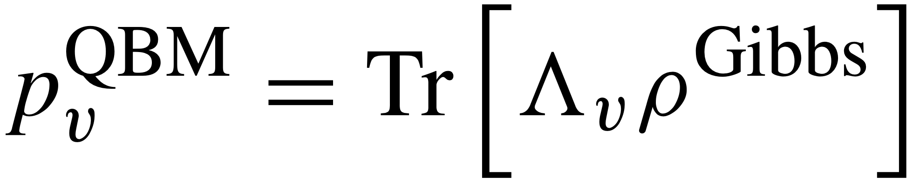
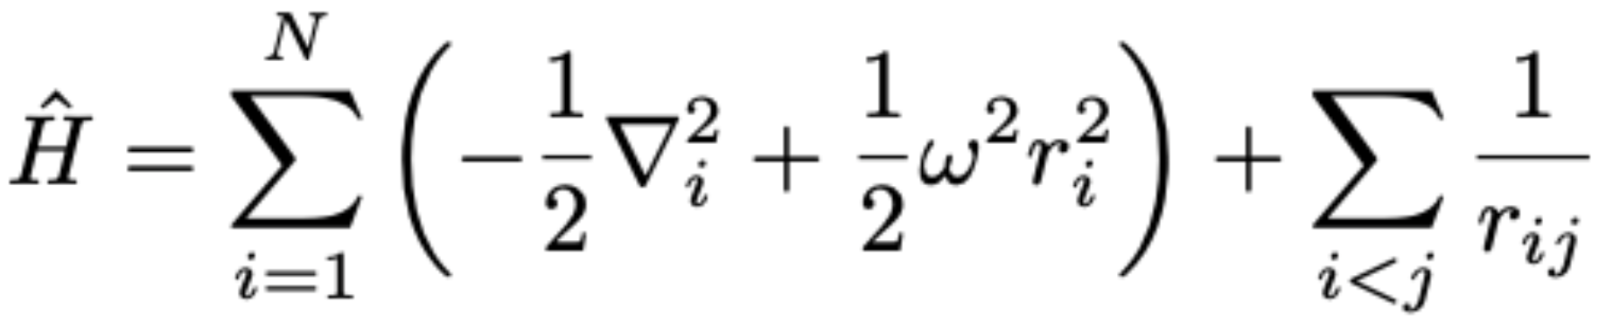
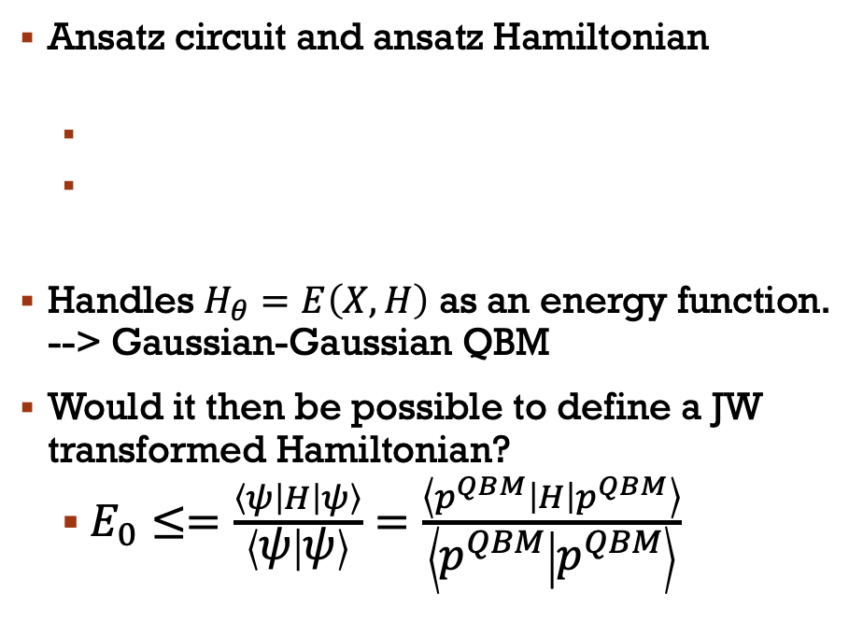
Apply QBM to quantum system: IDEA
Classic BM
Quantum BM
One ansatz(NQS):
Ansatz circuit and ansatz Hamiltonian
Handles $H_{θ}=E\left(X,H\right)$ as an energy function. --> Gaussian-Gaussian QBM
Would it then be possible to define a JW transformed Hamiltonian?
$E_{0}≤=\frac{\left\langle ψ\left|H\right|ψ\right\rangle }{\left\langle ψ | ψ\right\rangle }=\frac{\left\langle p^{QBM}\left|H\right|p^{QBM}\right\rangle }{\left\langle p^{QBM} | p^{QBM}\right\rangle }$

Slide 26
Plan further on:
Complete the Jordan Wigner transformation of the pairing Hamiltonian and maybe some other Hamiltonian also?
Compute the energy/Check if the p^QBM is an eigenstate, compare with the classical BM
Run the QBM on the fraud dataset, find best parameters and test with multiple H_\theta
Run the QBM with handwritten digits
Write thesis
Include more if not enough/ or more time

